Slide 1





PRESENTATION 2026
[NeuroVista DataVine]
Student Name
Student Email
Suhabi Sen
suhabisen@gmail.com
Mentor Name
Umamaheswari

Slide 2

Outline
Abstract of the Project
Problem Statement
Proposed Solution
System Architecture
Live Demo of the Project
Embedded Video of Project
Conclusion
Future Scope

Slide 3
Abstract
This project addresses - Skill-mismatch, Credential Inflation, Ghost Hiring, Disguised Unemployment, Re-training and Return to education, Estimation Bias and Industry- Education gap for Primary Beneficiaries and Stakeholders and Secondary Beneficiaries
comparison of the job markets in the United States of America and India.
Goal- develop data-driven analytical framework, evaluate and interpret the job market, improve transparency, compensation alignment, and workforce decision-making
Tools and Technologies - Microsoft Excel, Power BI, Power BI Q&A Visual, Microsoft Copilot Studio Agent, Microsoft Azure, Streamlit App

Slide 4

Problem Statement
The core problem addressed in this project is the WAGE CHASM (38.7x) between US and India
Gaps include- lack of transparency and miscommunication between stakeholders (India's 28.4% salary non-disclosure rate), Job postings datasets- highly unstructured, containing inconsistencies, lack of prompt engineering/ digital literacy skills of applicants
Stakeholders
Limitations- Lack of Integrated Analytical Frameworks, Static and Non-Interactive Reporting, Limited Predictive Capabilities, Accessibility Challenges

Slide 5

Proposed Solution
Approach:
Data Structuring → AI Analysis → Dashboard Insights → AI Assistant
Impact:
Individual: Career guidance
Organizational: Better hiring decisions
Societal: Reduced skill gap & improved workforce alignment
Key Innovations of the Proposed Solution
Combines data analytics (Excel and Power BI) + AI (Microsoft Copilot Studio) having human-centric design
E.g. Salary prediction model act as a salary negotiation tool

Slide 6
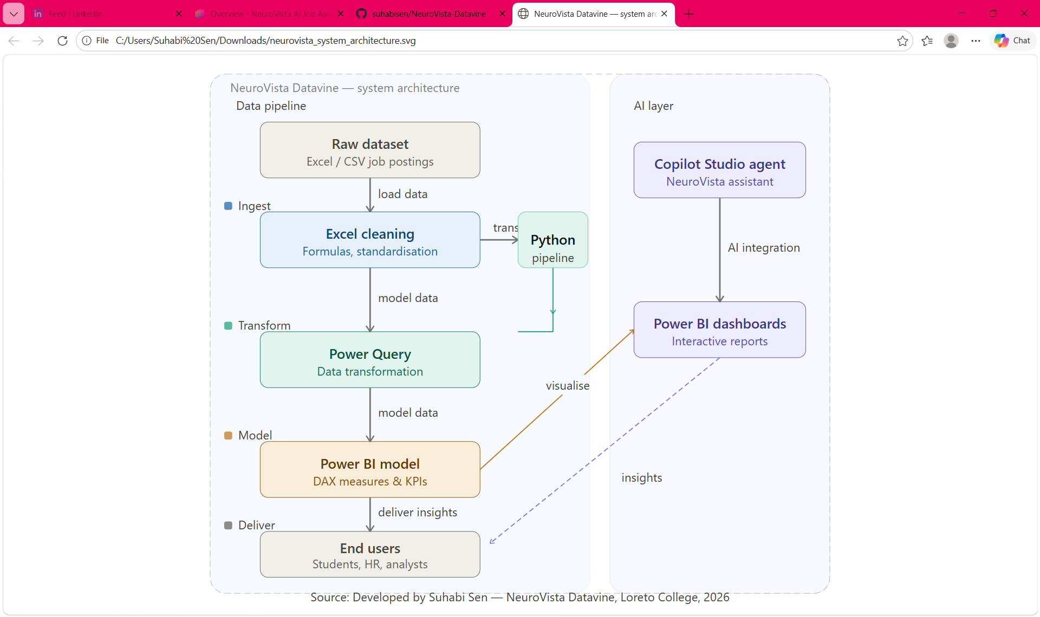
System Architecture

Slide 7
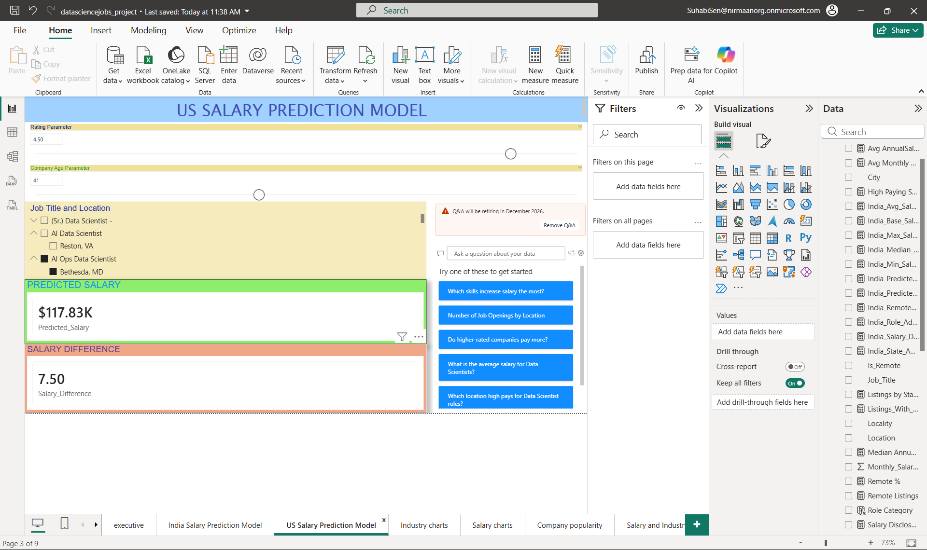
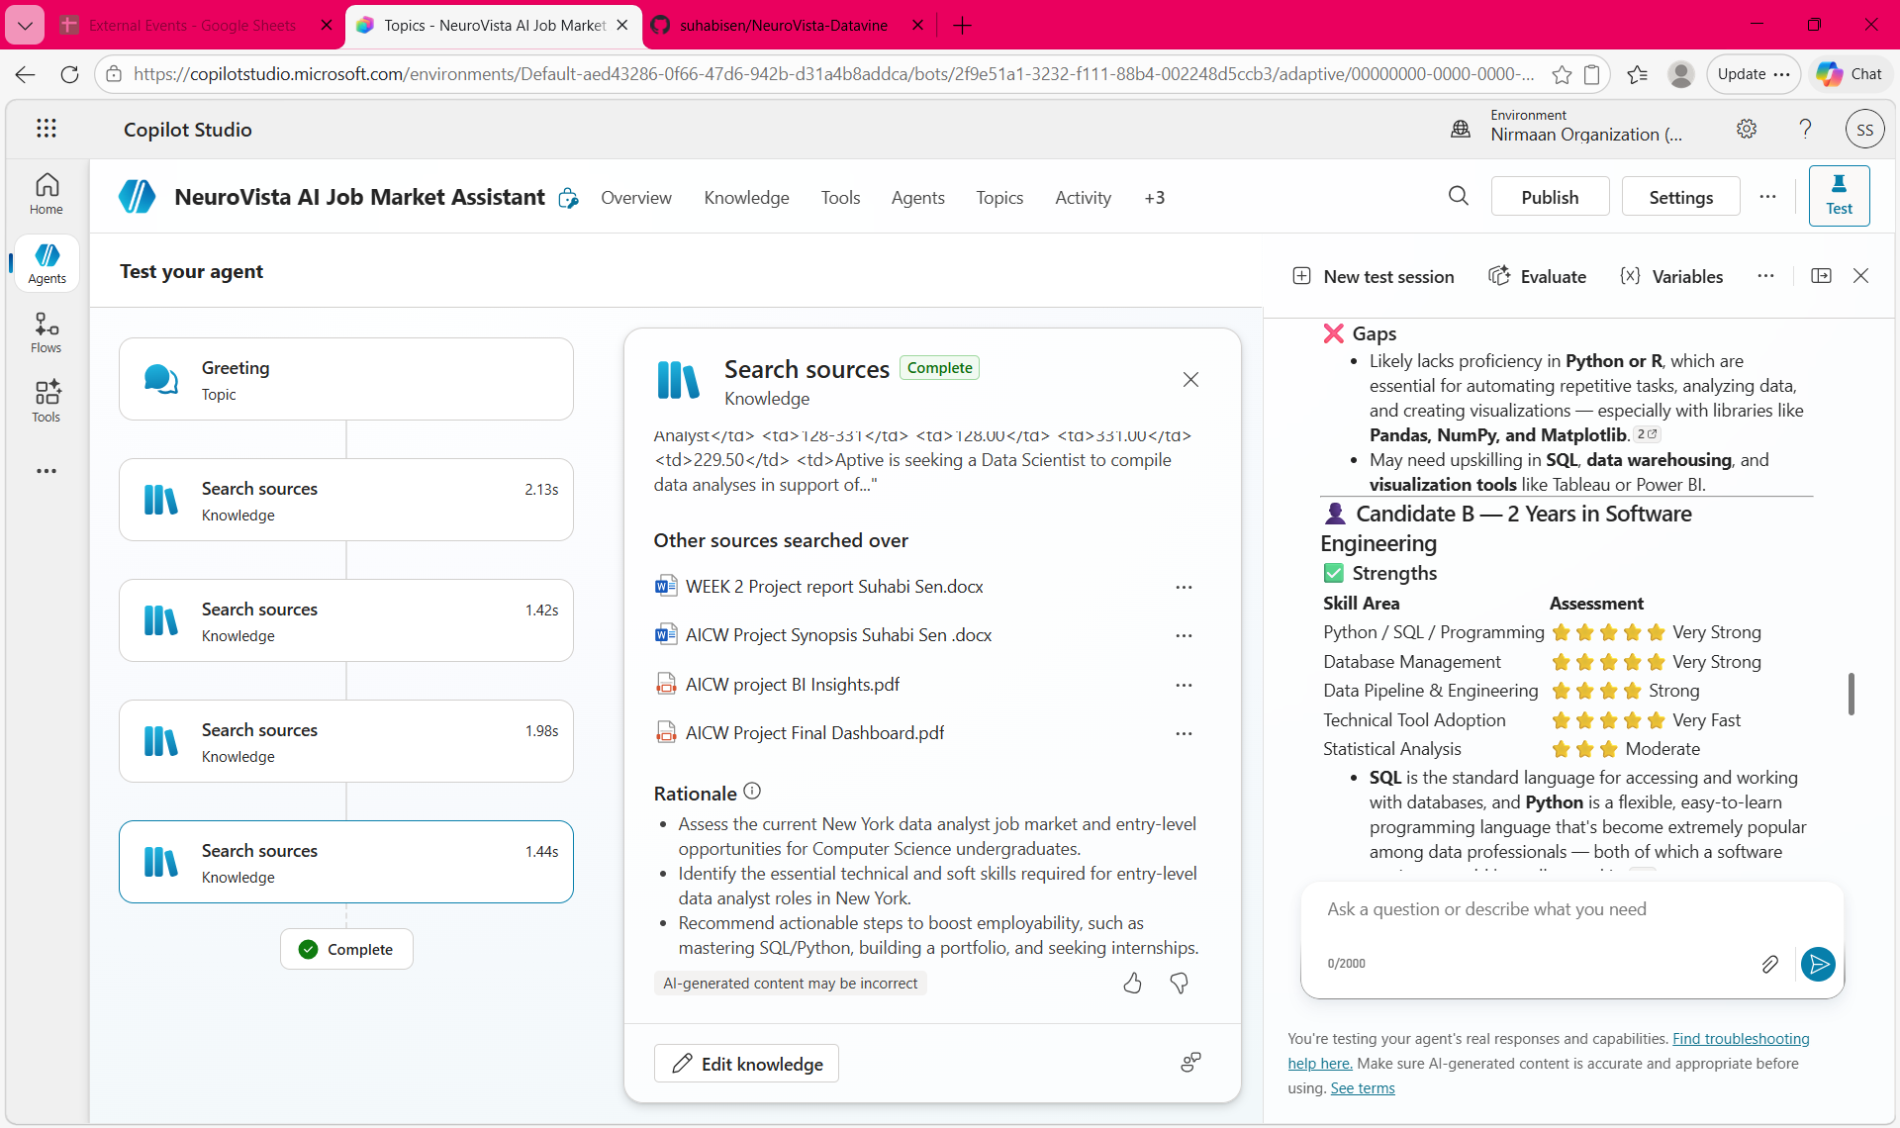
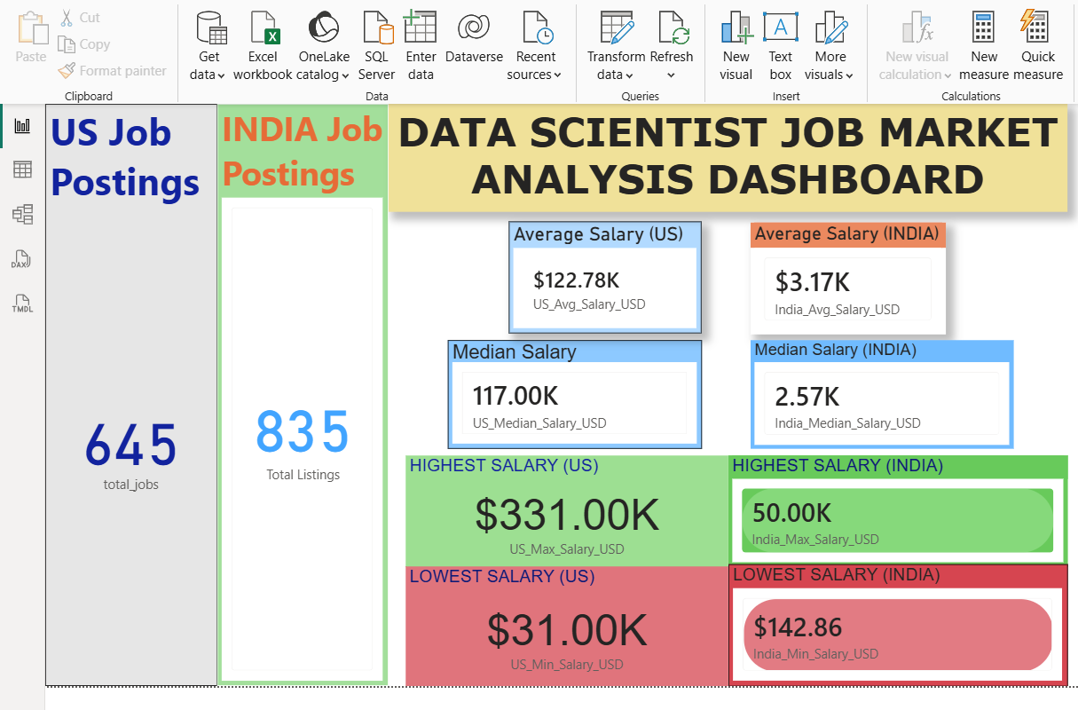
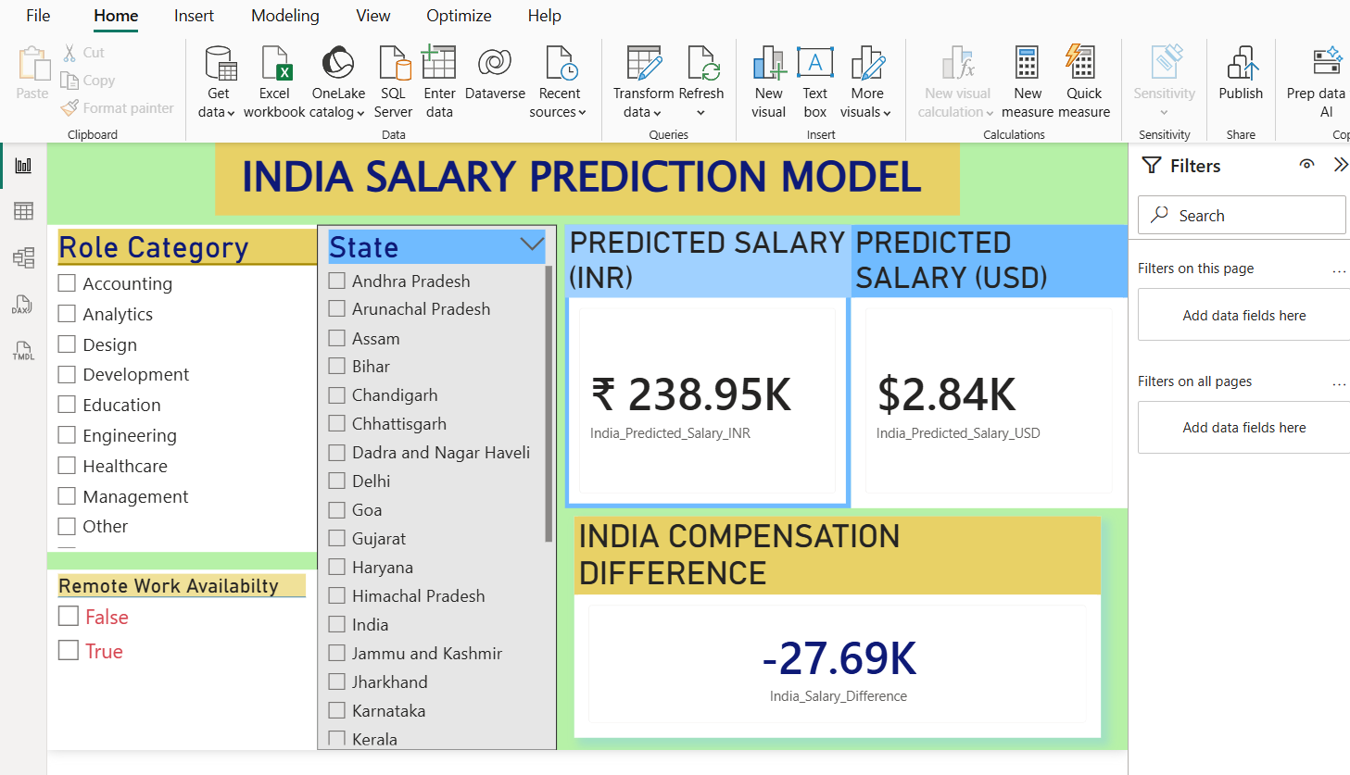
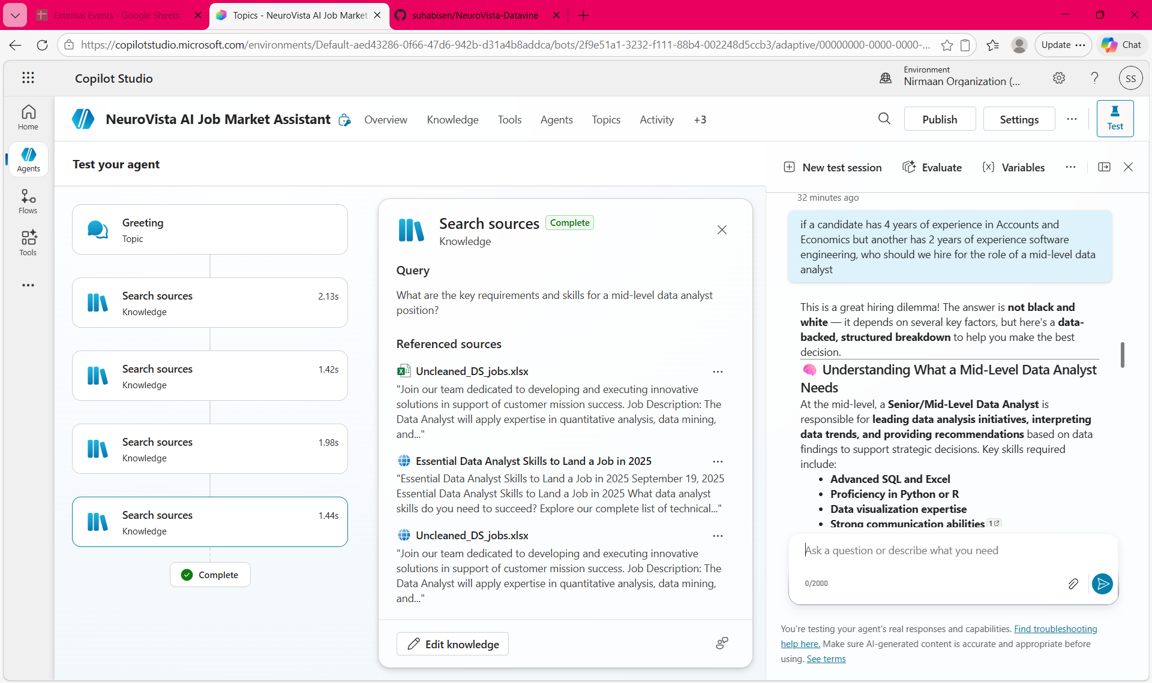
Live Demo of Project
Demo 1: US and India Salary Prediction Models
Demo 2: AI Chatbot (NeuroVista Assistant)
Demo 3: Executive Dashboard
https://lemon-plant-0030f010f.7.azurestaticapps.net

Slide 8
https://drive.google.com/file/d/1wFiFHYxnnBm82Pwq4IWiAKfVUbb20t3m/view?usp=drive_link
Video of Project Demo
▶
[Insert your project demo video.
You can embed a video your live project.]

Slide 9
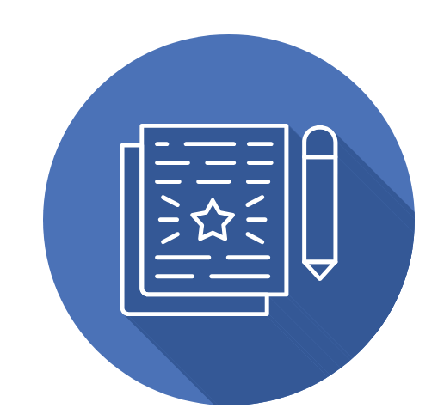
Conclusion
Challenges Addressed- understanding job market dynamics in the United States and India, and skill requirements in the data science domain
(rapid technological changes create a gap between industry expectations and workforce readiness)
Learning objective success in
Practical experience in data analytics and visualization
Hands-on exposure to AI Chatbot integration in business workflows
Deeper understanding of how data influences economic and organizational decision-making
scalable and impactful model for intelligent job market analysis

Slide 10

Future Scope
Integration of Real-Time Data Pipelines. E.g. LinkedIn API Integration
2. Implementation of Machine Learning Models
3. Development of a User-Friendly Application Interface and productise as a Public tool

Slide 11
Thank You
AICW Fellowship | Student Project Presentation 2026
LinkedIn | Edunet Foundation

